Slide 1

CAFE Table RESERVATION system
RLL-GROUP 1

Slide 2
Team members
ID | NAMES | GROUP
2582583 | Aruna Ramanan P (Team Lead) | 1
2584457 | Anurag Pandit | 1
2582657 | Ankit Kumar Bhaskar | 1
2583634 | Ashish Yadav | 1
2583551 | Chainpur Ankita | 1
2583393 | Daneshwari Badiger | 1
2583786 | Deepika Verma | 1

Slide 3
Contents
Title
Contents
Introduction
Objective
Tools and Technologies
Database Schema
Admin and User Components
Cafe Table Reservation Website
Testing Reports
Postman Testing Reports
Conclusion
Thank You

Slide 4
Introduction
In the fast-paced world of today, people are constantly seeking convenient and efficient ways to dine out and enjoy their favorite meals at cafes and restaurants.
The traditional method of making table reservations and interacting with cafes is evolving towards a more digital and user-friendly experience.
To cater to this growing demand, our project aims to develop a modern and robust "Cafe Table Reservation System."

Slide 5
Objectives
The primary objective of this project is to create a comprehensive Backend RESTful Web Services infrastructure to power the Cafe Table Reservation System.
User-Friendly
Flexible
Customer Engagement

Slide 6






Tools and Technologies

Slide 7
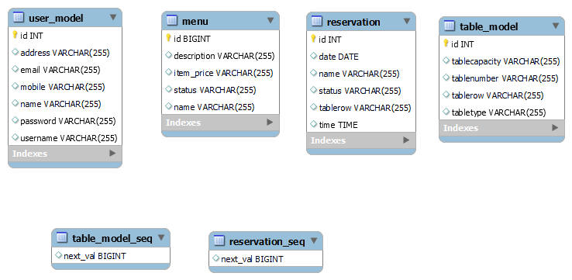
Database schema

Slide 8
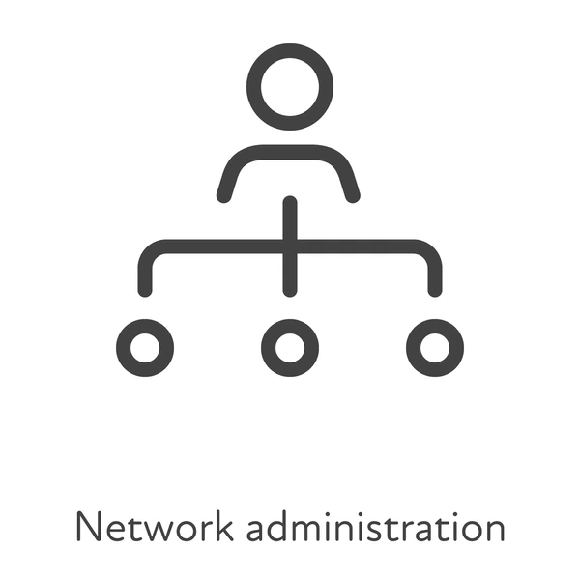
Admin and User Components

Slide 9
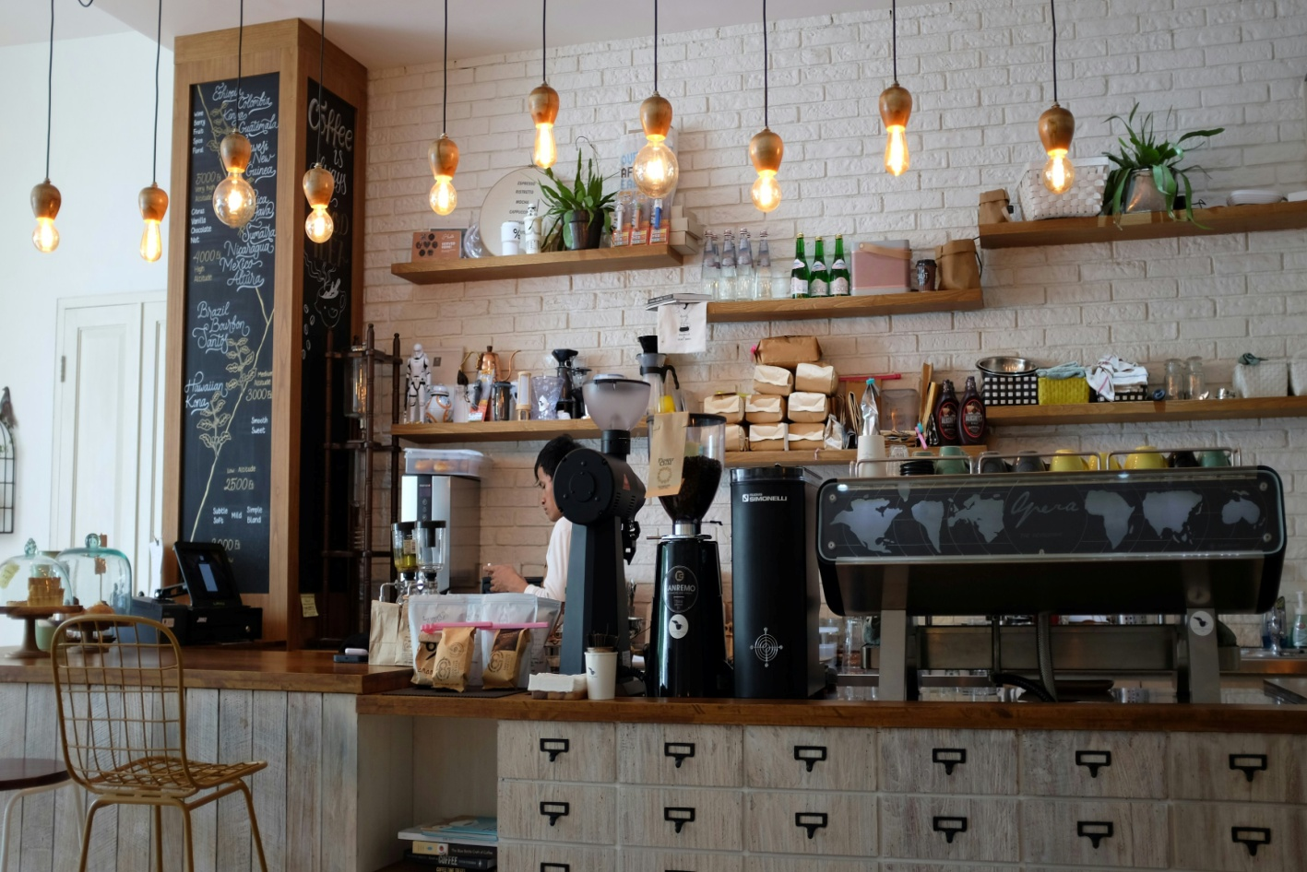
Admin Components
Admin Login Module
Admin Dashboard
Menu Module(CRUD)
Table Module
Reservation Module

Slide 10
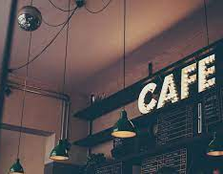
User Components
User Login Module
User Dashboard
About Us
Menu module
Special Item
Search table Module
Reservation Module
Update profile
Contact Us

Slide 11
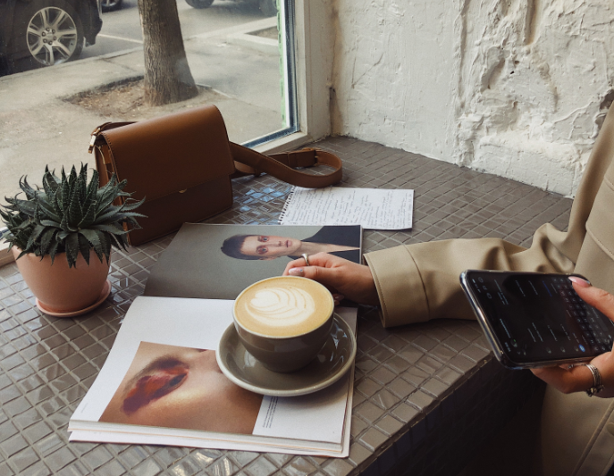
Outcome
Attract New Customers
Enhanced Customer Experience
Maximum Table Turnover
Improved Operational Efficiency

Slide 12
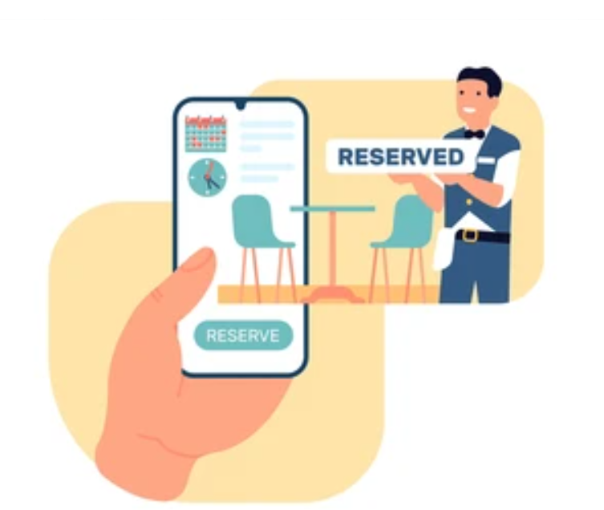
Cafe Table Reservation Website

Slide 13
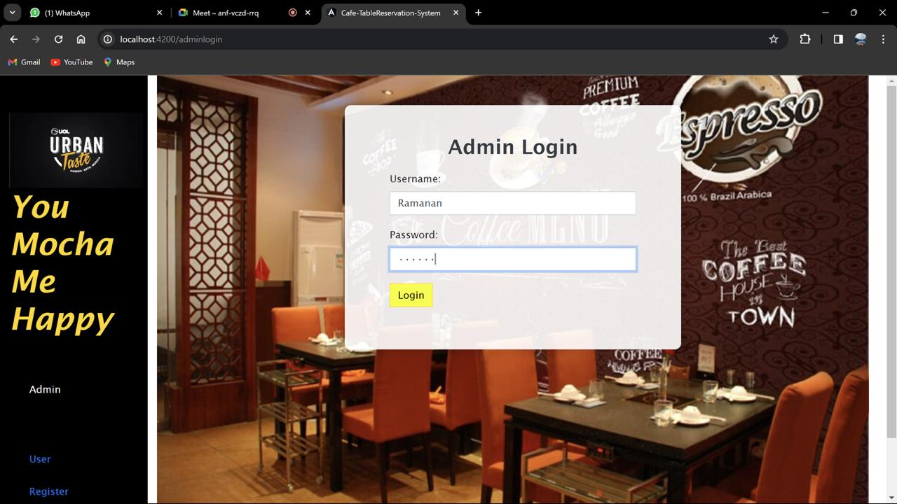
Admin Login
Admin login is to validate admin credentials.
If credentials are matched, it will redirect to Admin dashboard
Ifwe enter wrong credentials system will give message invalid credentials.

Slide 14
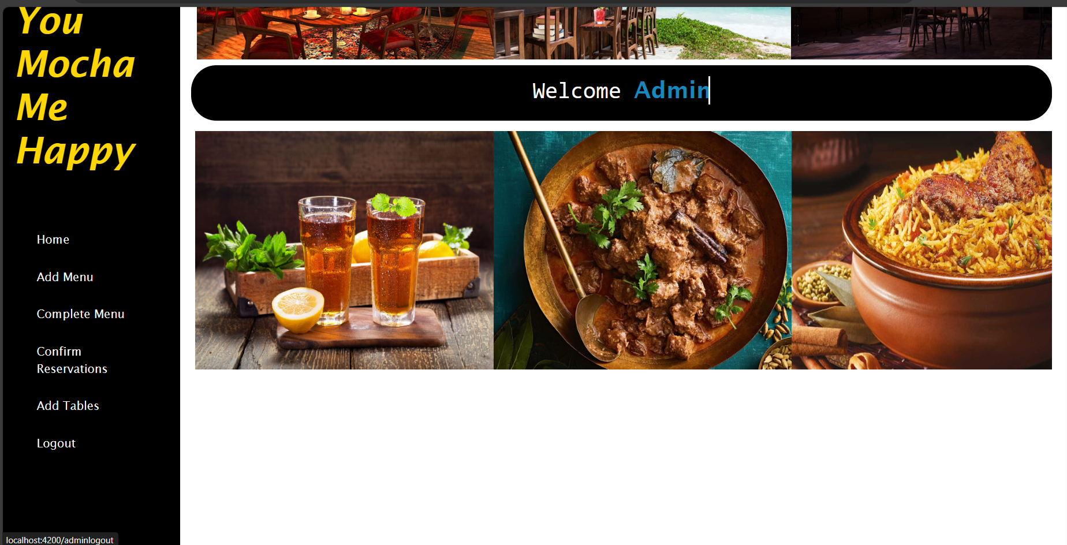
Logout Admin
Logout is used to sign out from the admin account and navigate back to admin login page.

Slide 15
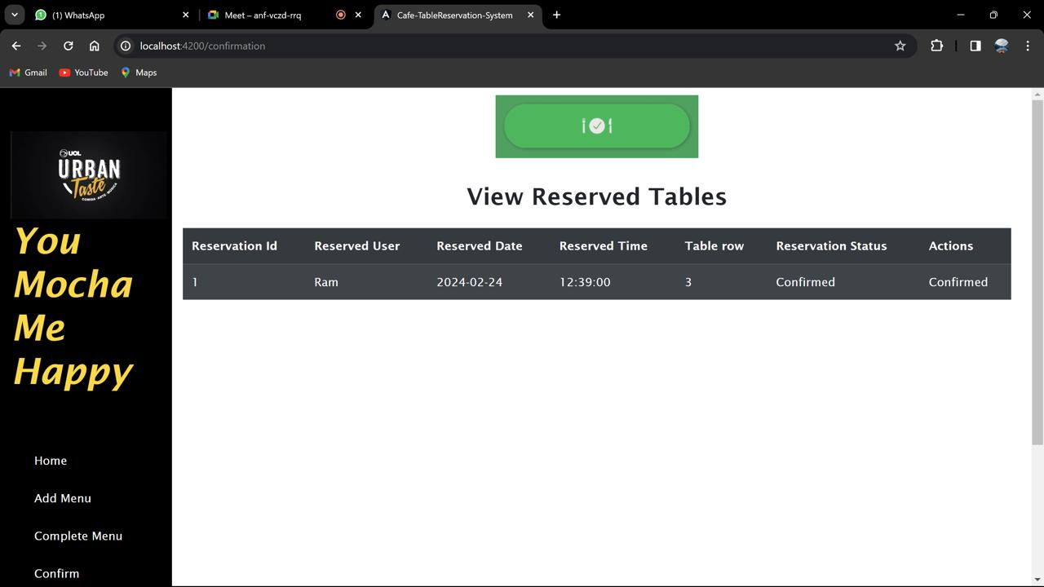
Confirm Reservation
Admin Module where admin can login and Approve table request.
In confirm reservation module of admin login ,we have the list of reservations made by all users.
Default status of each reservation will be pending, once approved status will be turned to confirm.

Slide 16
Reserved Tables
User Module where user can login and reserve a table with their appropriate date and time.
In search tables modules of user login, we have the option to search and reserve.
Based on id, date and time it will be post and the default status will be in pending.

Slide 17
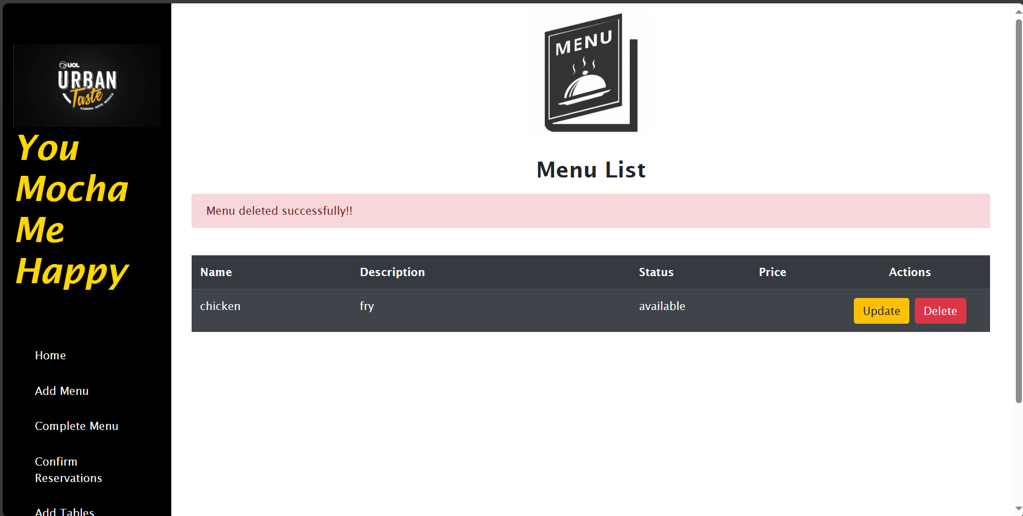
Delete Menu Item
It retrieves the menu item based on the provided name and deletes it.
menu item doesn't exist, it throws an exception.

Slide 18
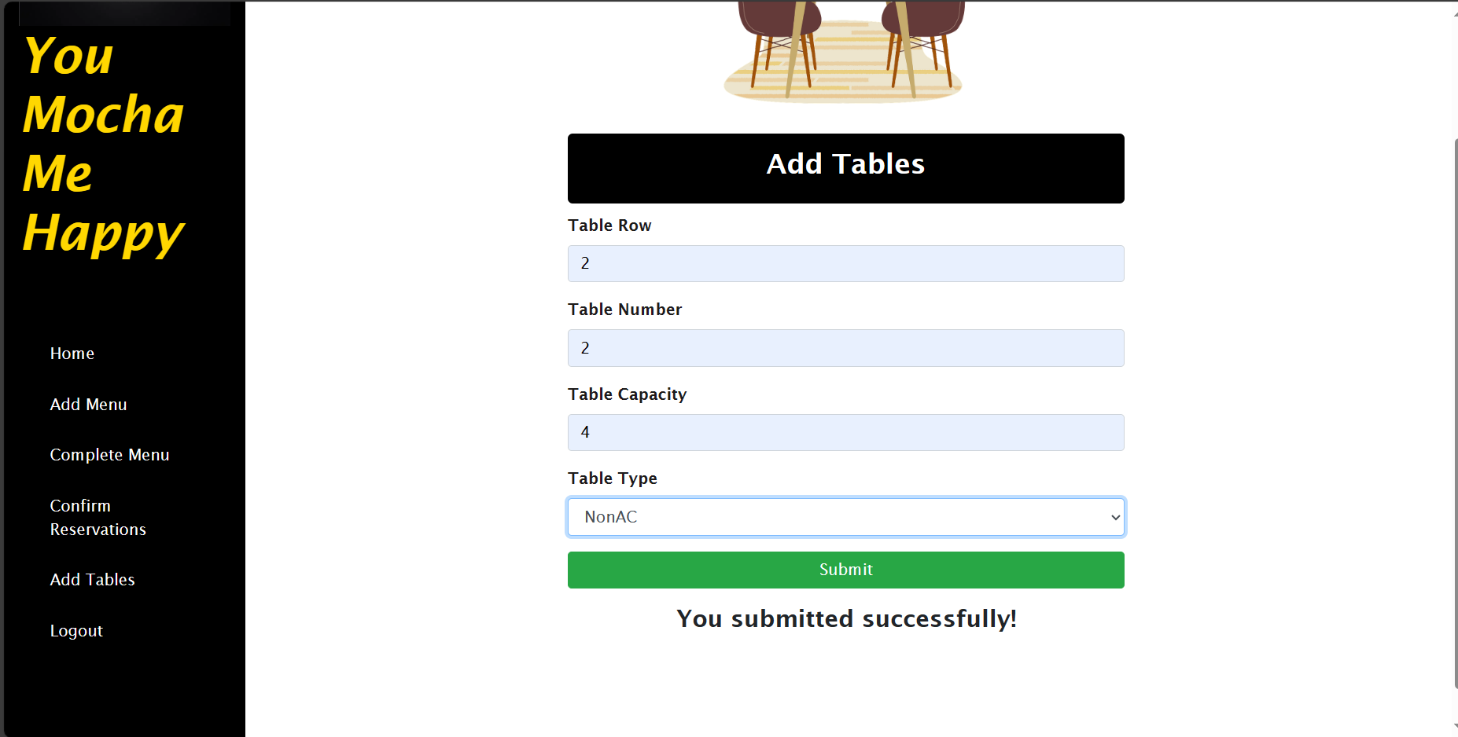
Add Tables
Only admin has the authority to add the table.
The system supports to add the table type(AC & Non AC).
Customer can able to search for the table required.

Slide 19
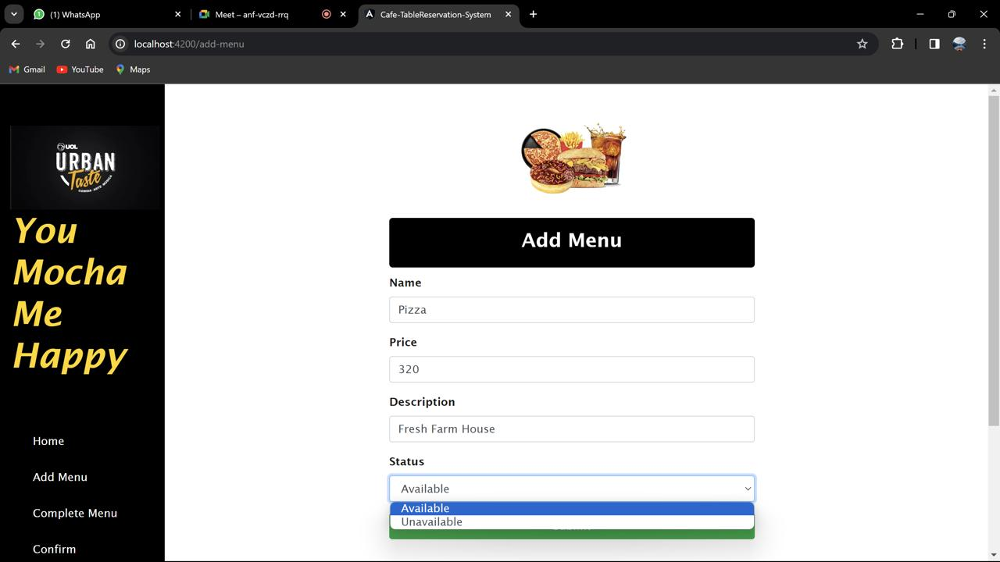
Update Menu Item
Form includes fields for Name, Price, Description, and Status
Bootstrap for styling and Angular for form handling
retrieves the menu details based on the provided name
The page displays a success message alert when the form is successfully submitted.

Slide 20
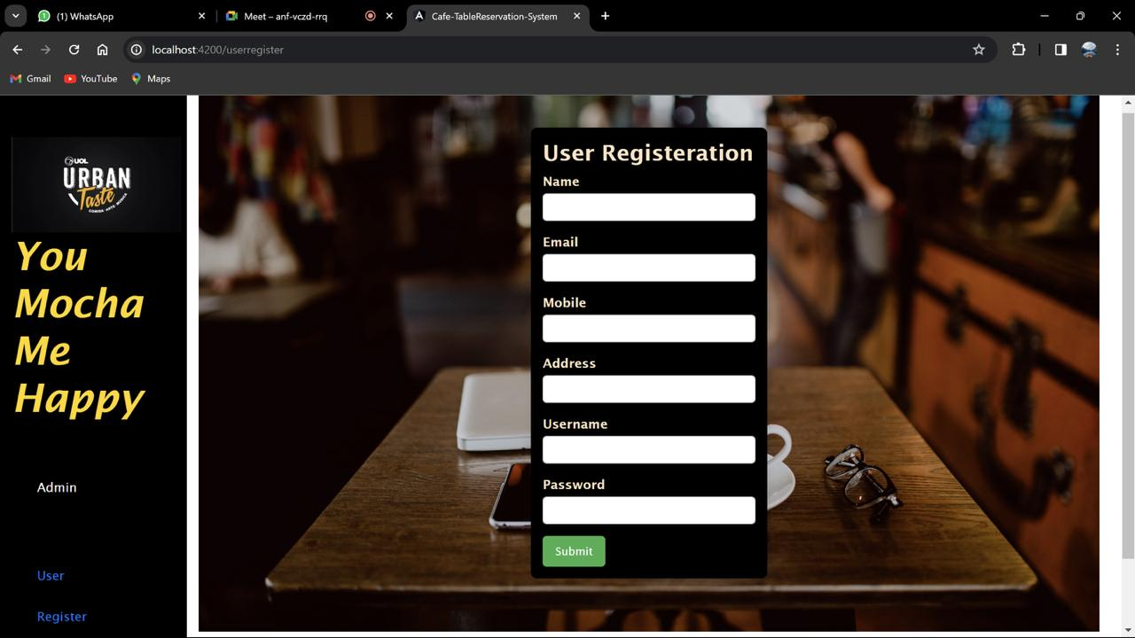
User Register
.User Register refers to the process where individuals sign up or create accounts on websites, platforms, or applications by providing necessary information such as username password mobile number
. Registered users normally provide some sort of credentials (such as username e-mail address and password) to the system in order to prove their identity this is known as logging in.

Slide 21
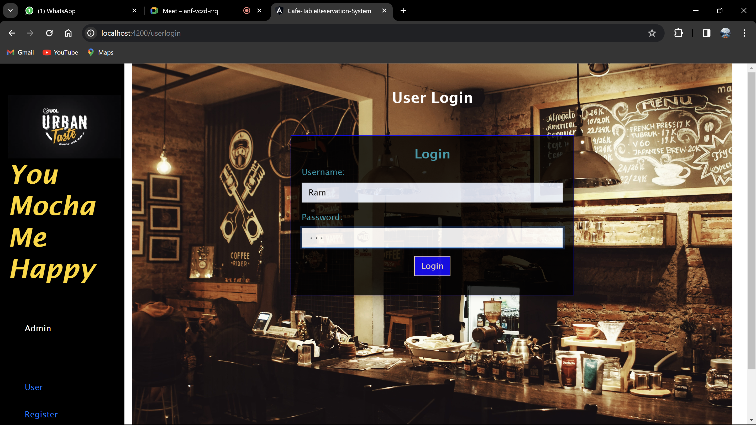
User Login
. User login is essential for securing
User accounts and ensuring that only authorized
Individuals can access specific resources or
information
. User login means a login and password that allows
access To the service

Slide 22
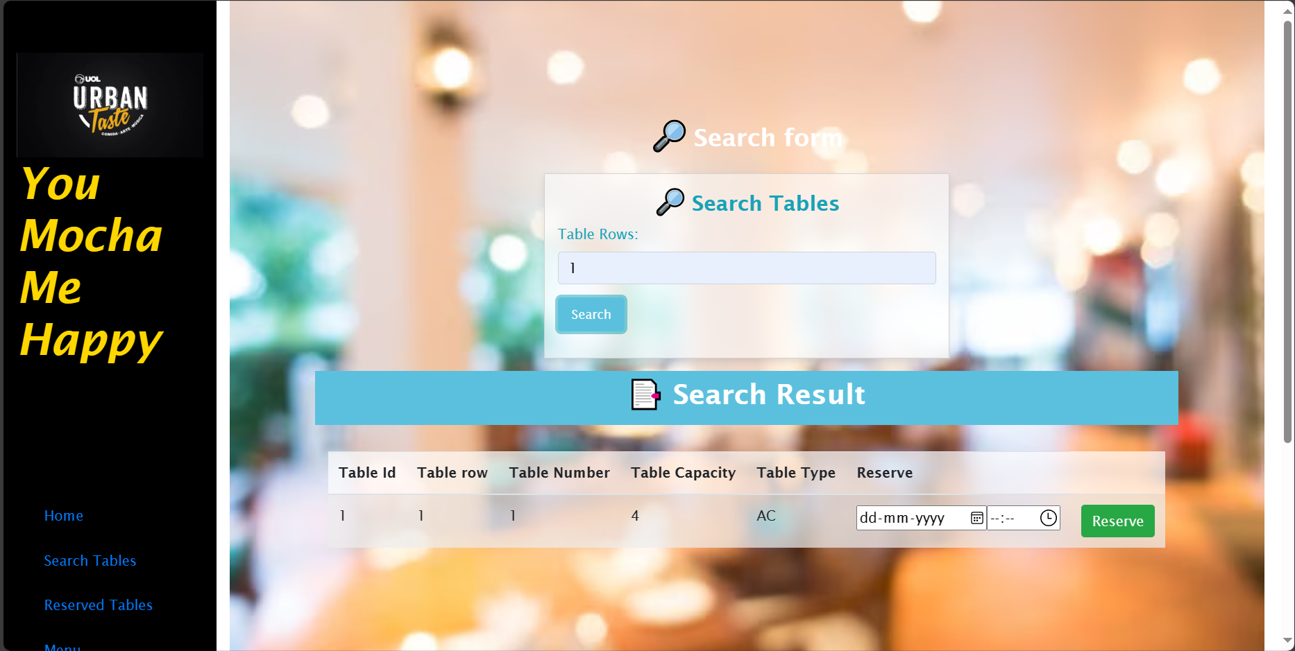
Search Tables And Book
Search Table helps the user to search for a particular table and the results related to the search record is display.
The User can choose the table type, table capacity and also reserve table for particular date and time.

Slide 23
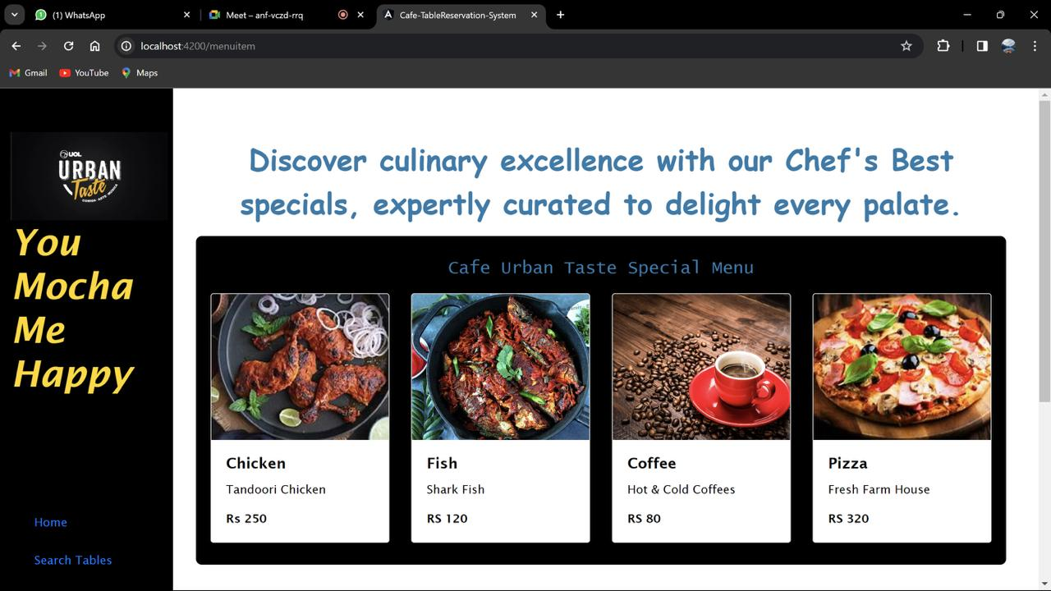
Special Item
Elevate your dining experience with our chefs' best creations
In this Slide User can see different types of special items and there prices which attract the user more towords the café.

Slide 24
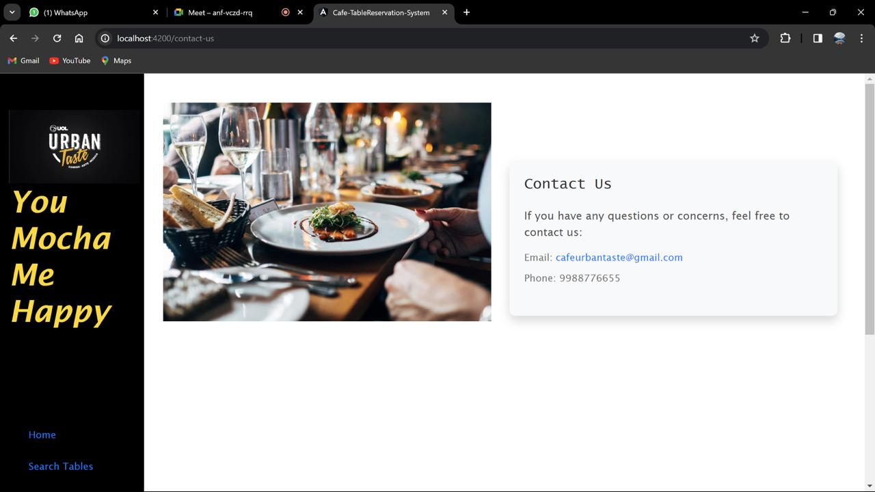
Contact Us
The "Contact Us" feature is a communication channel between customers and the owner, facilitating feedback and inquiries.
We are offering a cafe's email address and phone number for contact

Slide 25
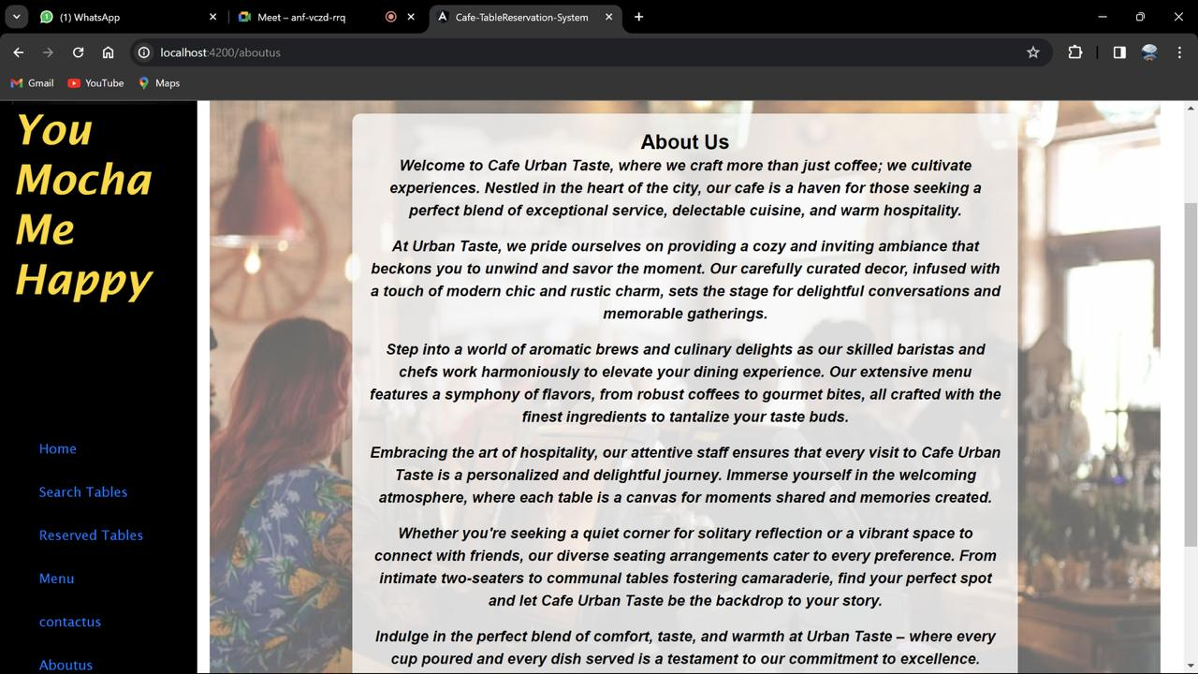
About Us
About Us section plays a important role in creating a positive impression, building trust, and providing valuable information to customers

Slide 26
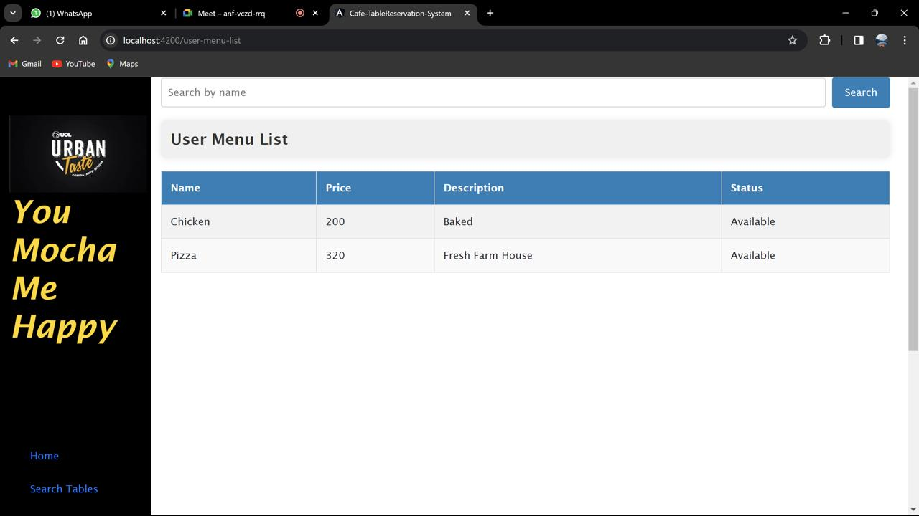
Menu List
Displays a list of menu items in a table also manages to display the updating, and deleting of menu items.
Error handling is implemented using operators

Slide 27
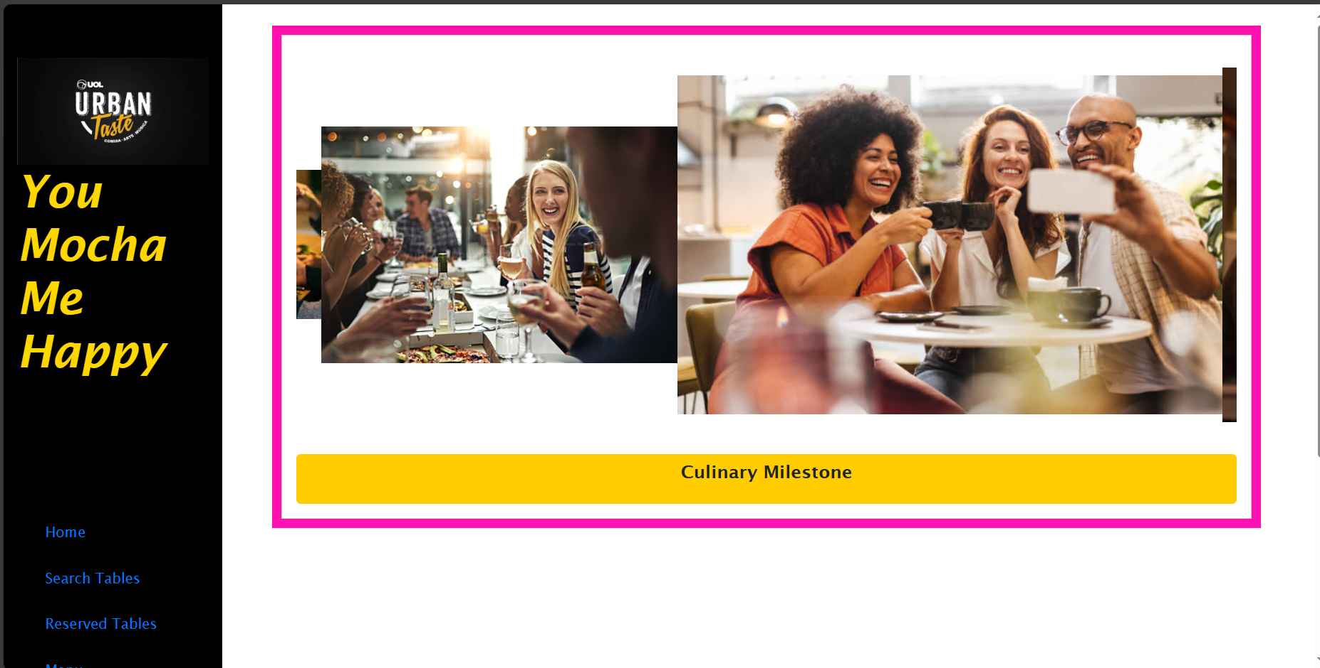
Gallery
Our visual showcase of beautifully set tables and some happy moments.
Explore our gallery for stunning visuals of the cafe ambience and delicious food.

Slide 28
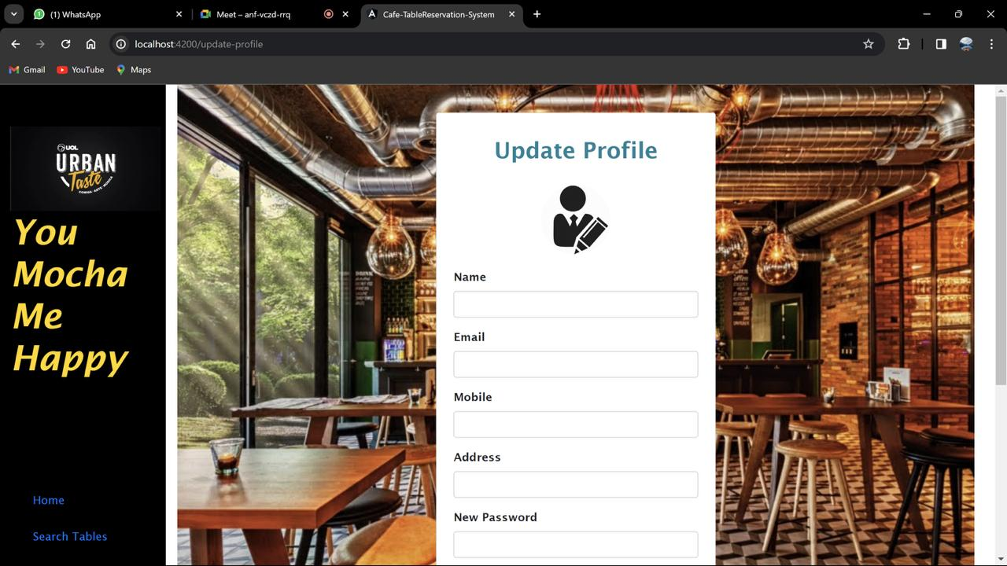
Update Profile
Update Profile helps in updating or editing the user details for his account

Slide 29

Testing Reports

Slide 30
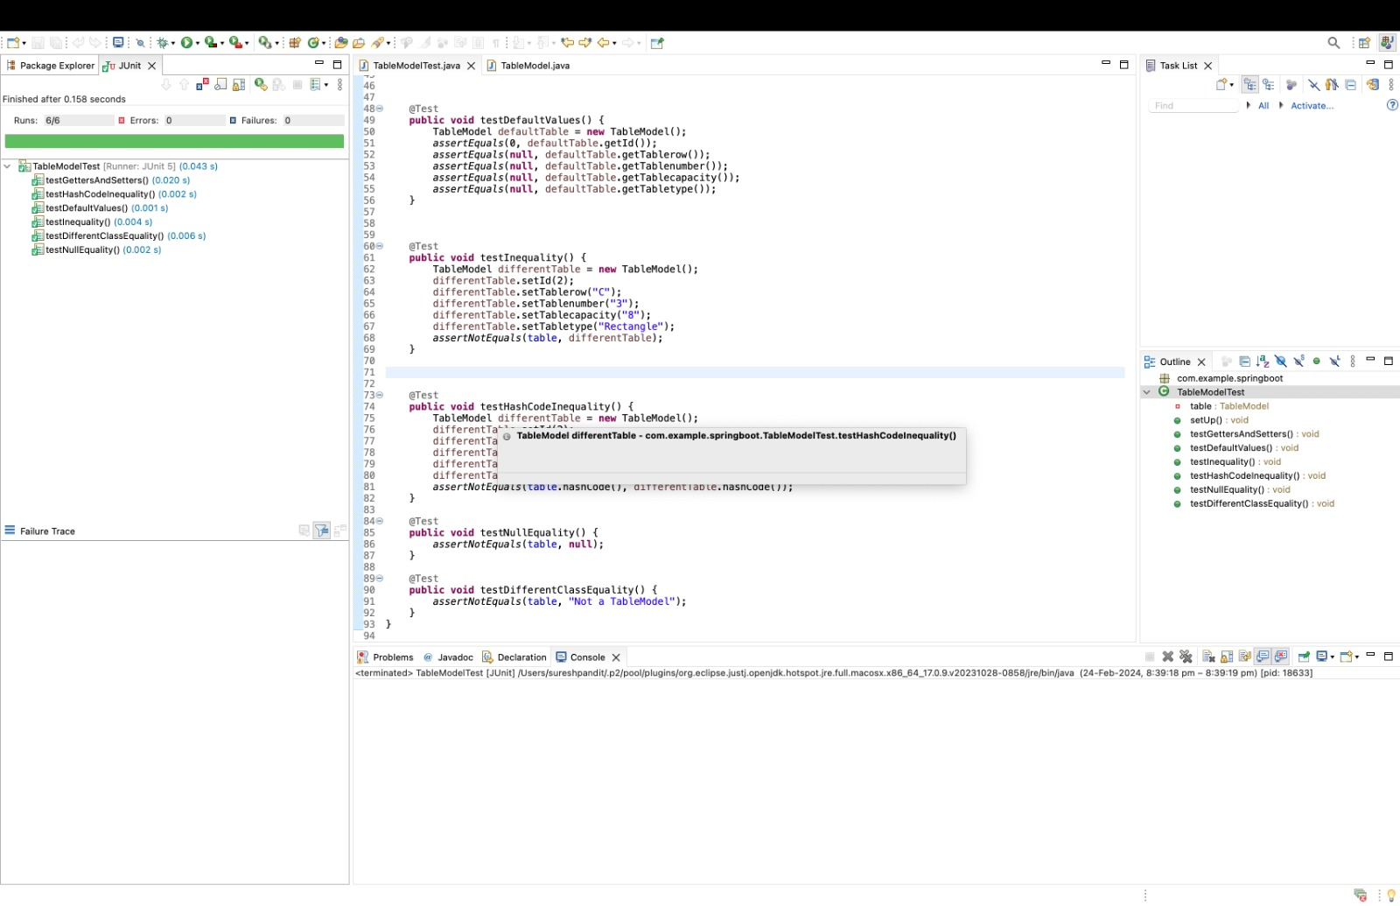
Testing reports TableModelTest

Slide 31
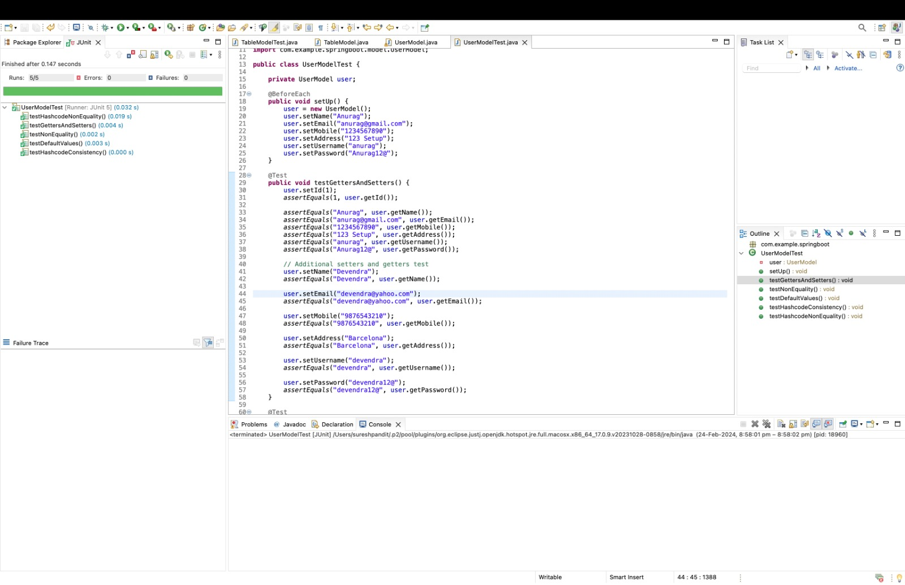
UserModelTest

Slide 32
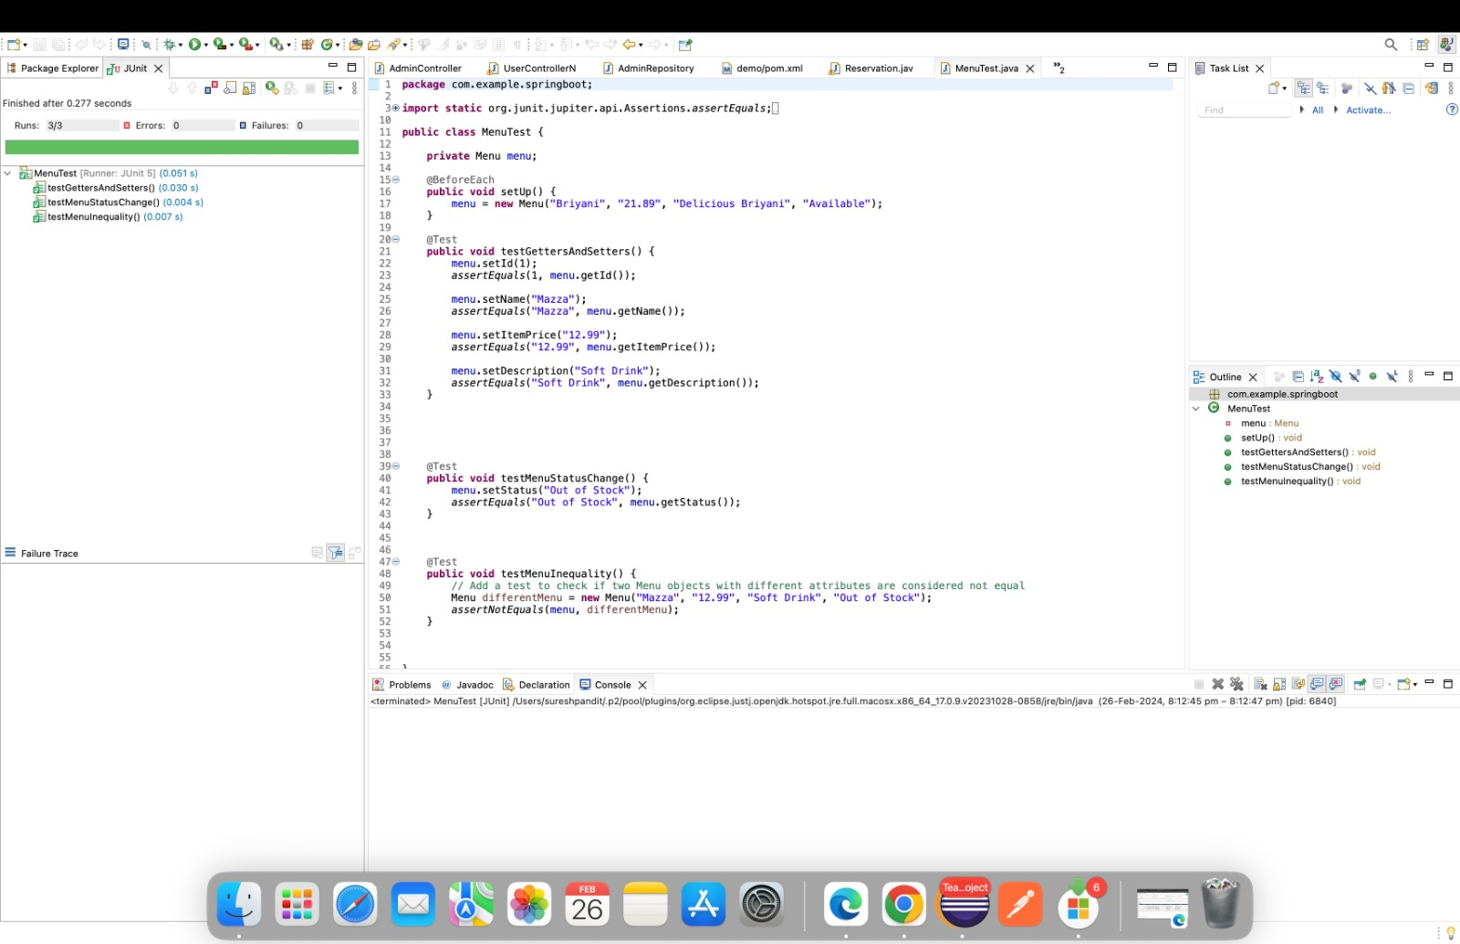
MenuTest

Slide 33
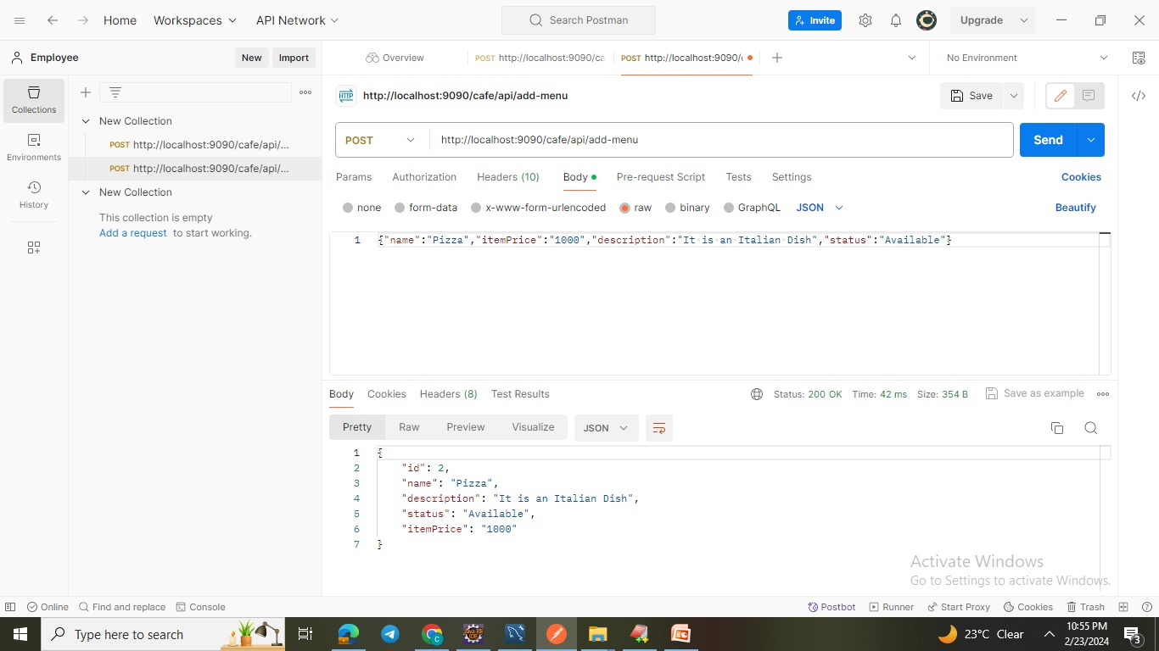
Postman Testing Reports Add menu

Slide 34
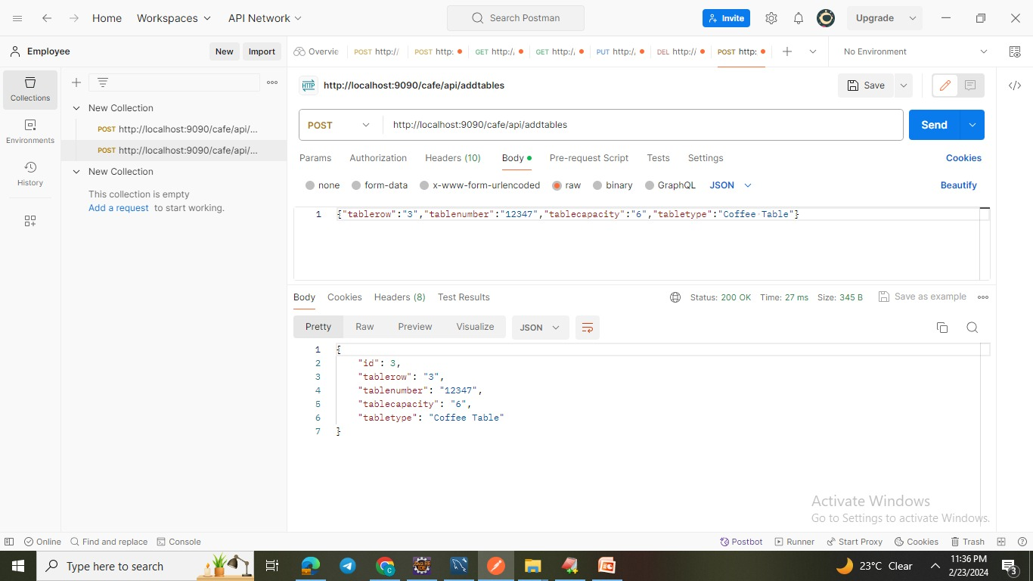
Add Tables

Slide 35
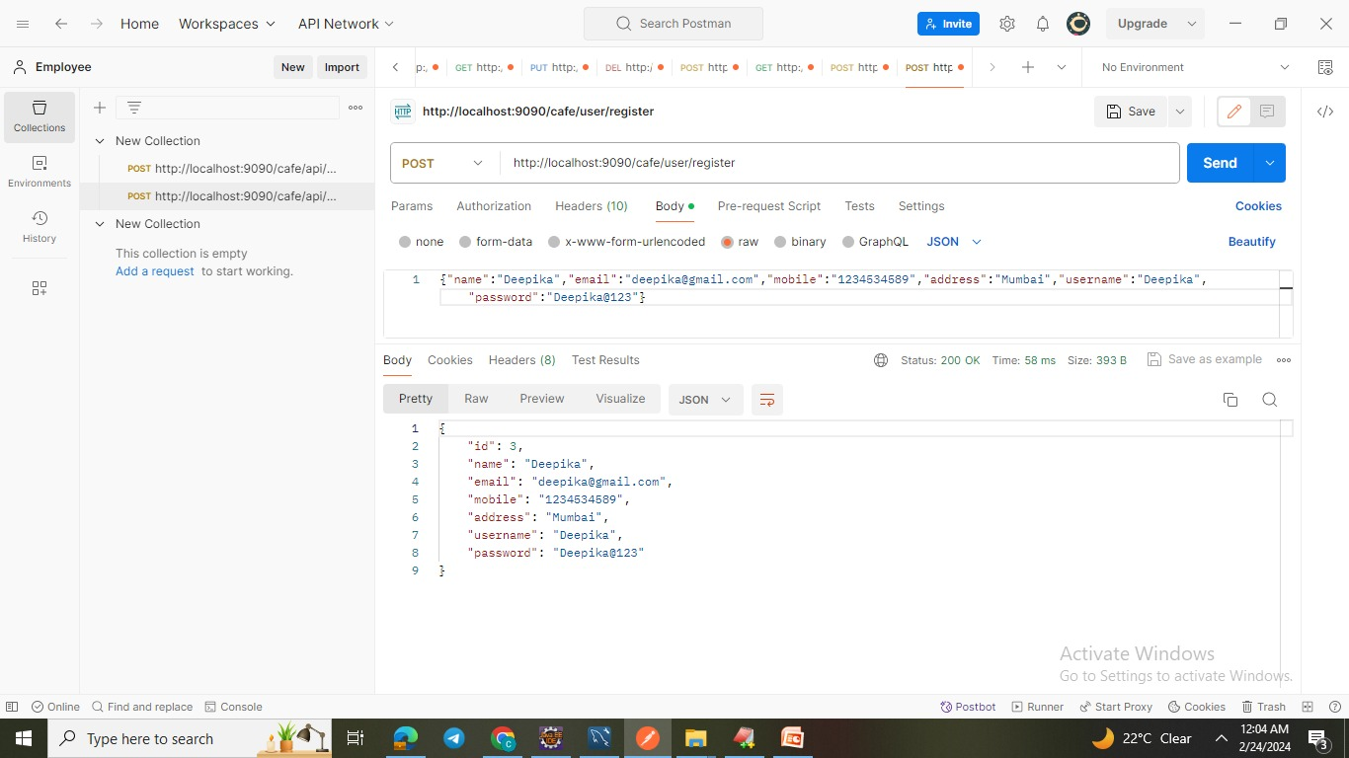
User Register

Slide 36
Conclusion
In conclusion, the "Online Cafe Reservation" project is a comprehensive and ambitious endeavour aimed at revolutionizing the way cafe enthusiasts interact with their favorite cafes.
By leveraging the power of Java Microservice architecture and a modern tech stack including Spring Boot, Spring Cloud, Spring Data JPA, MySQL, Docker, and more, this project seeks to deliver a robust and scalable backend infrastructure.

Slide 37

THANK YOU

